Slide 3
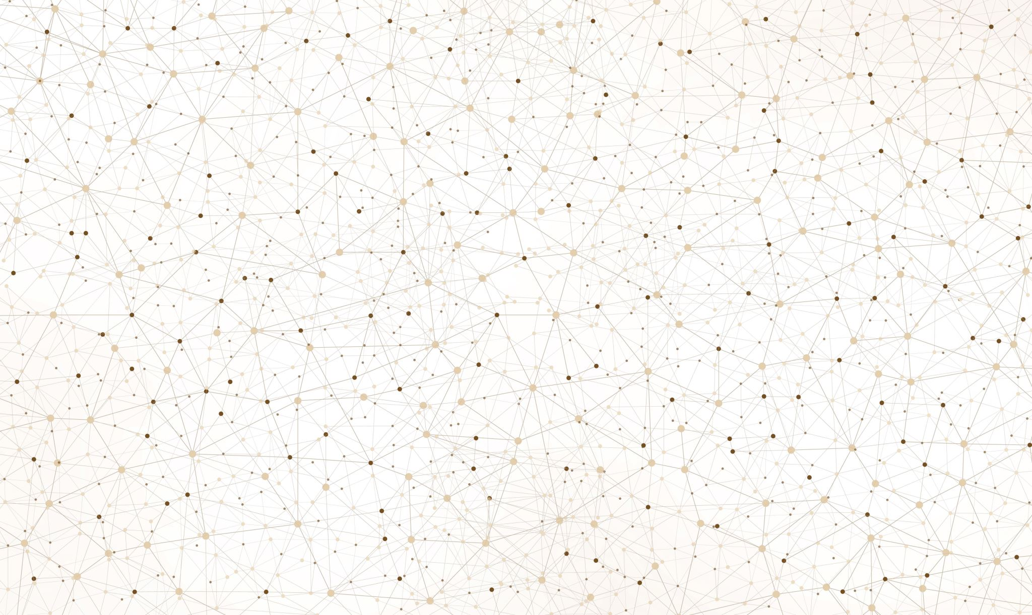
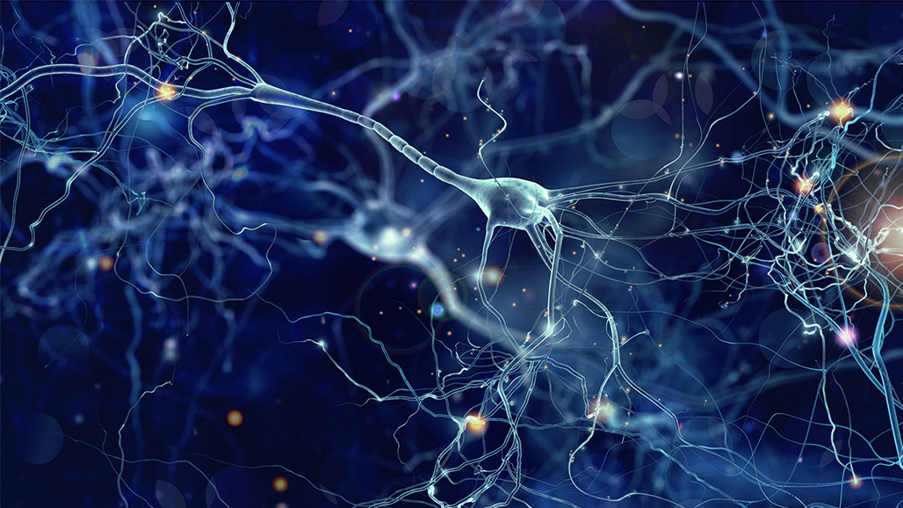
MEETING 4/25/23

Slide 4
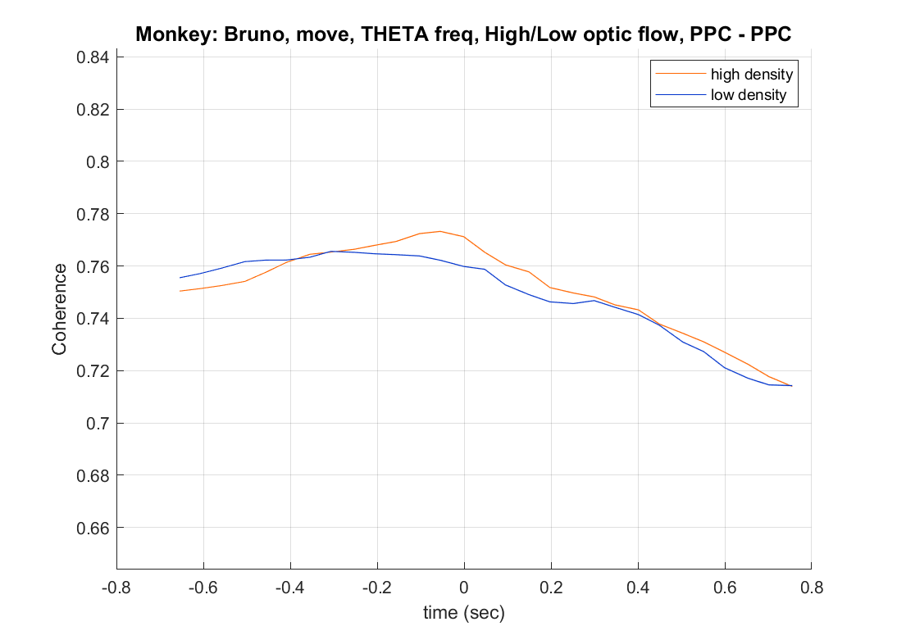
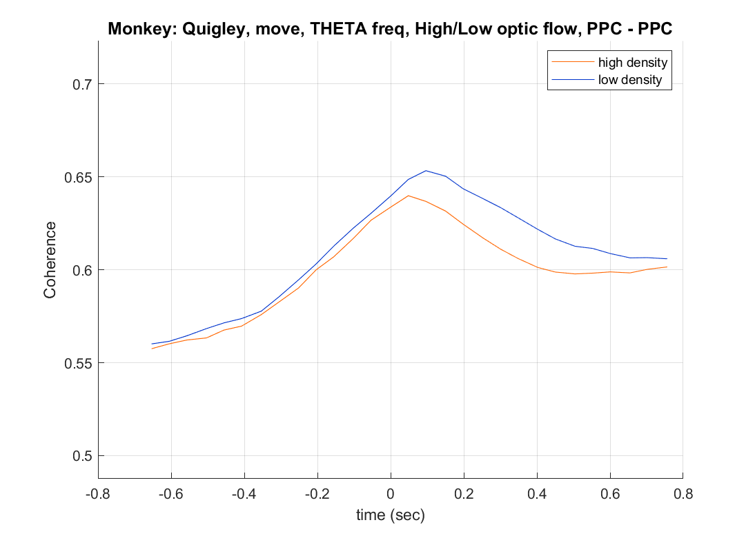
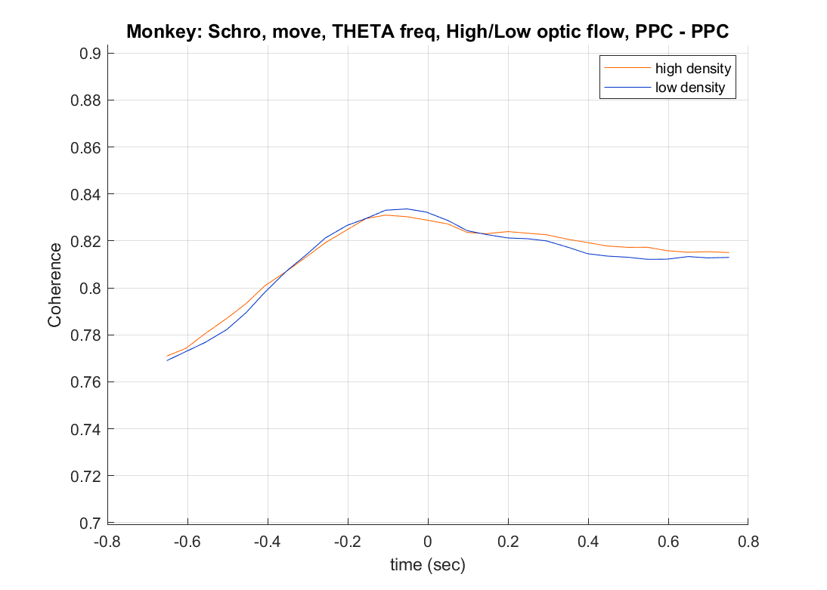

Slide 7
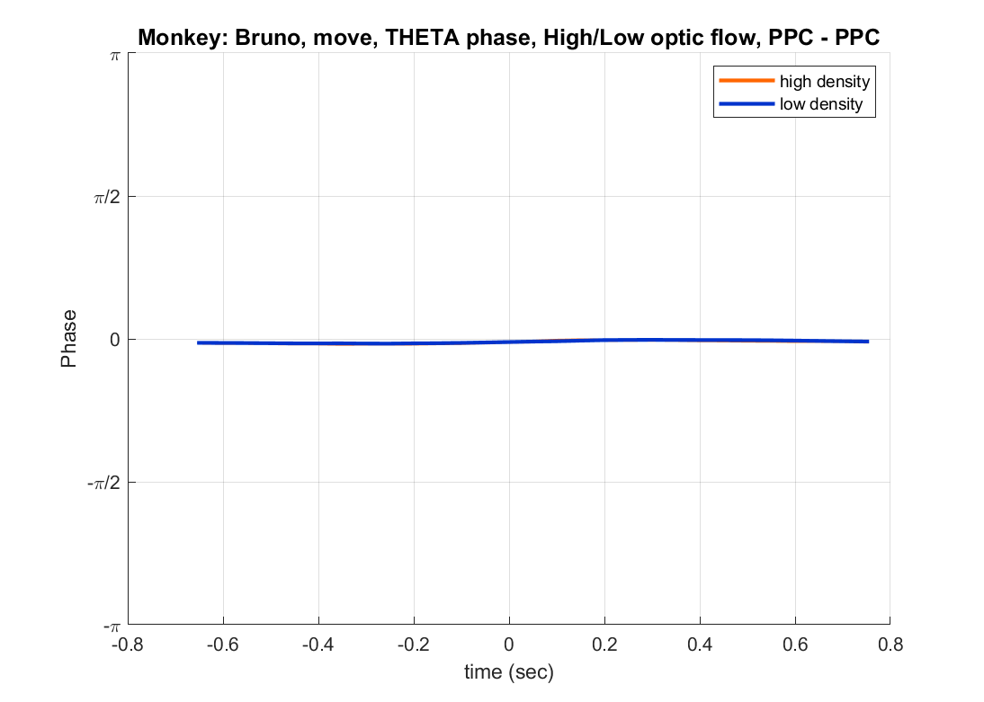
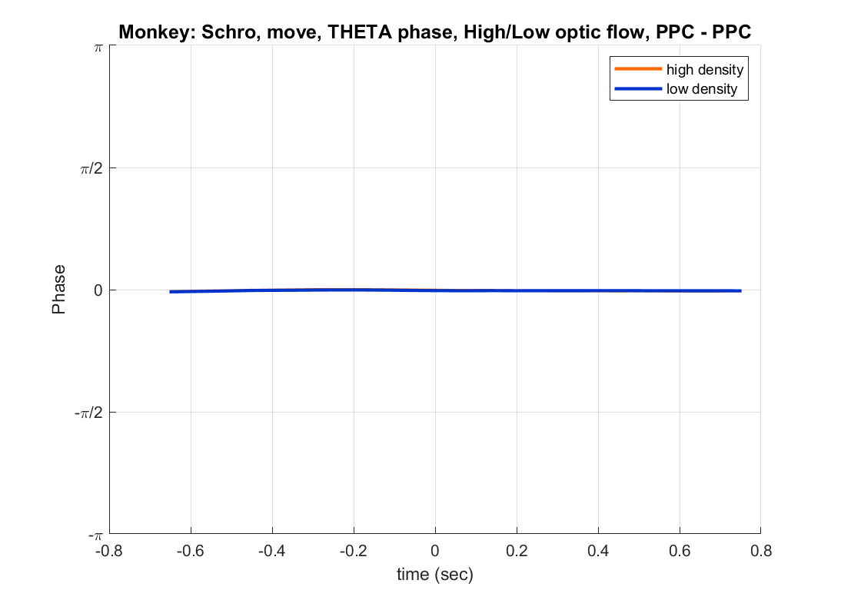
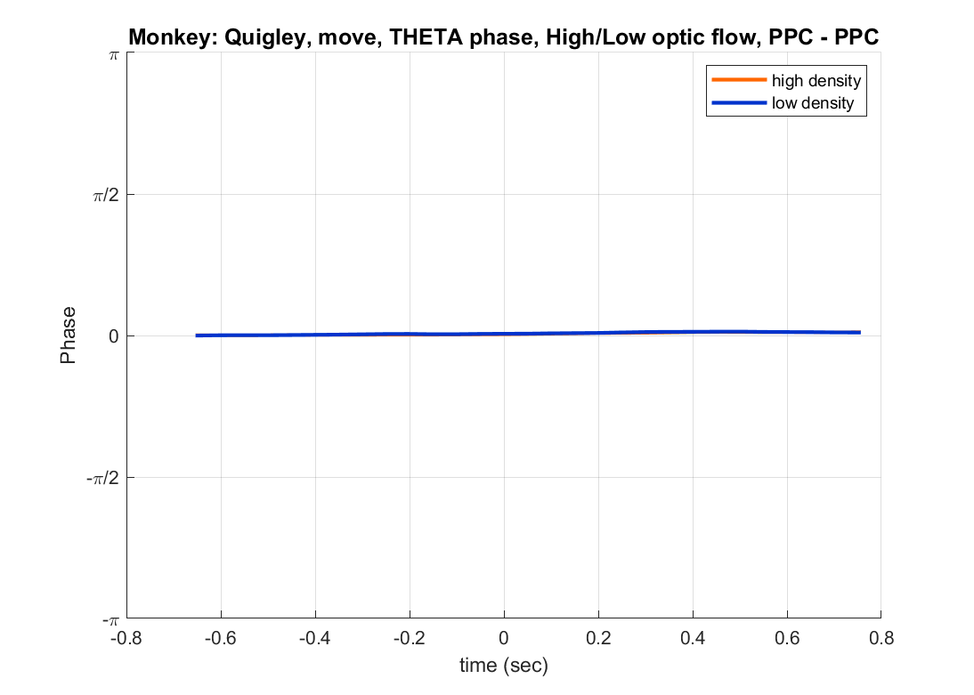

Slide 8
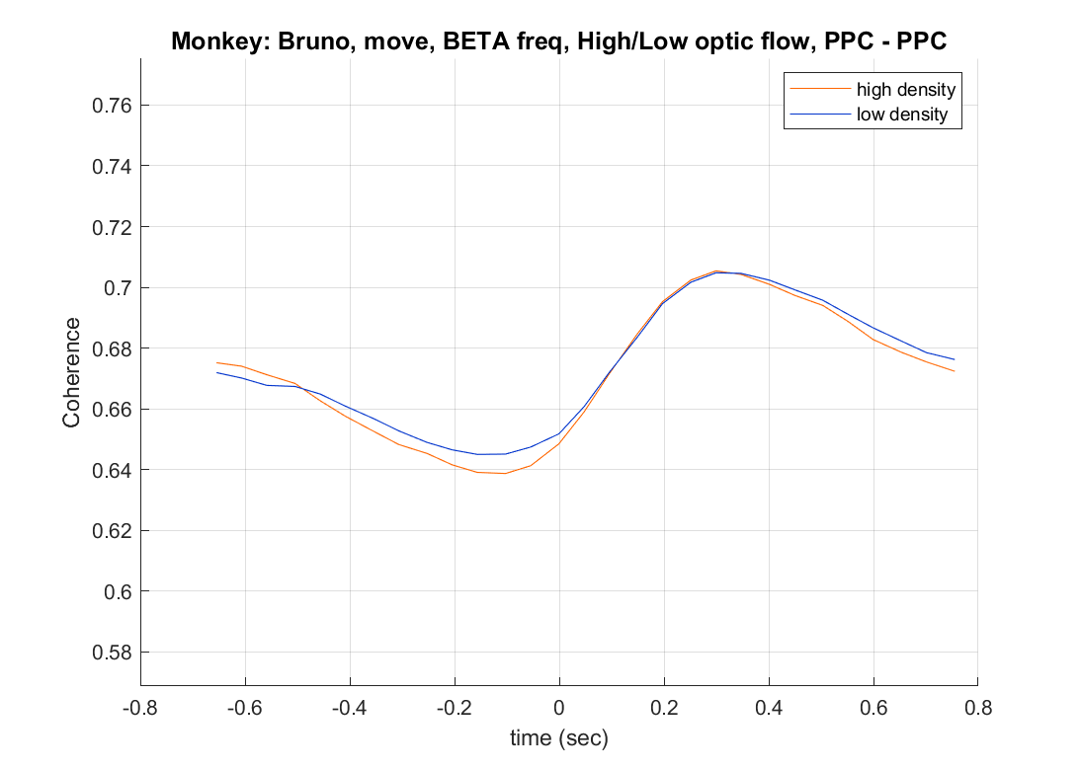
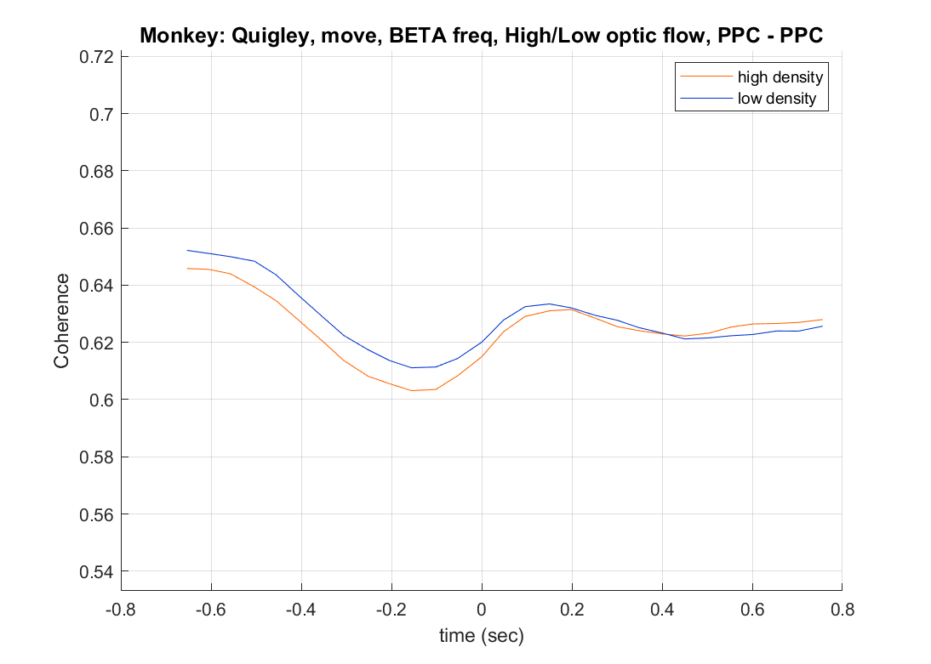
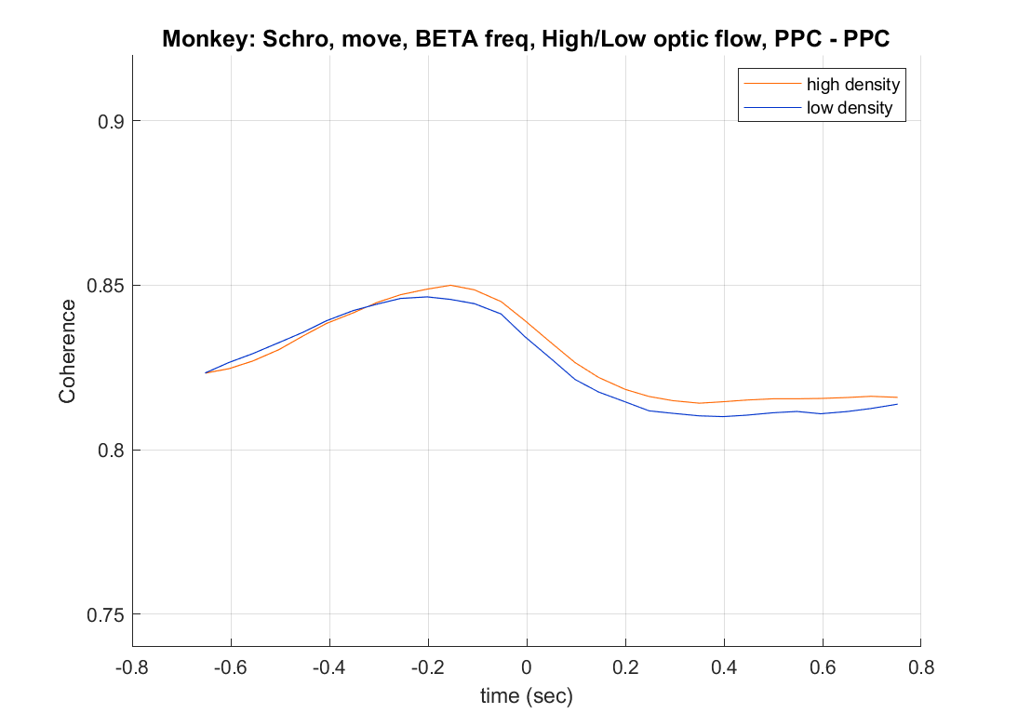

Slide 9
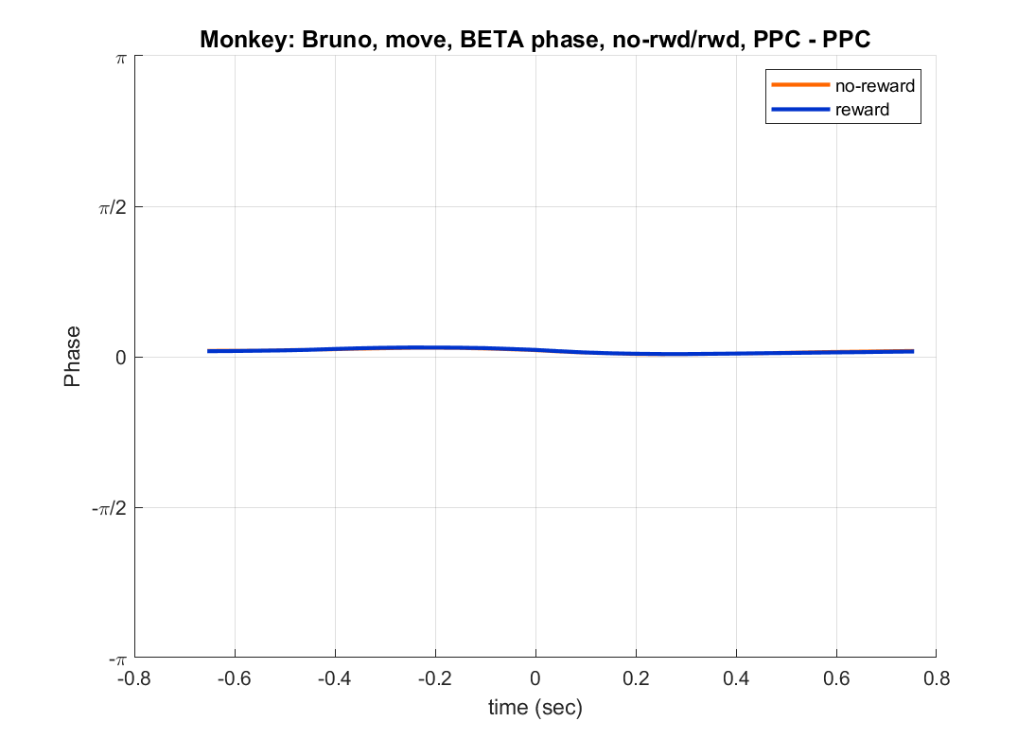

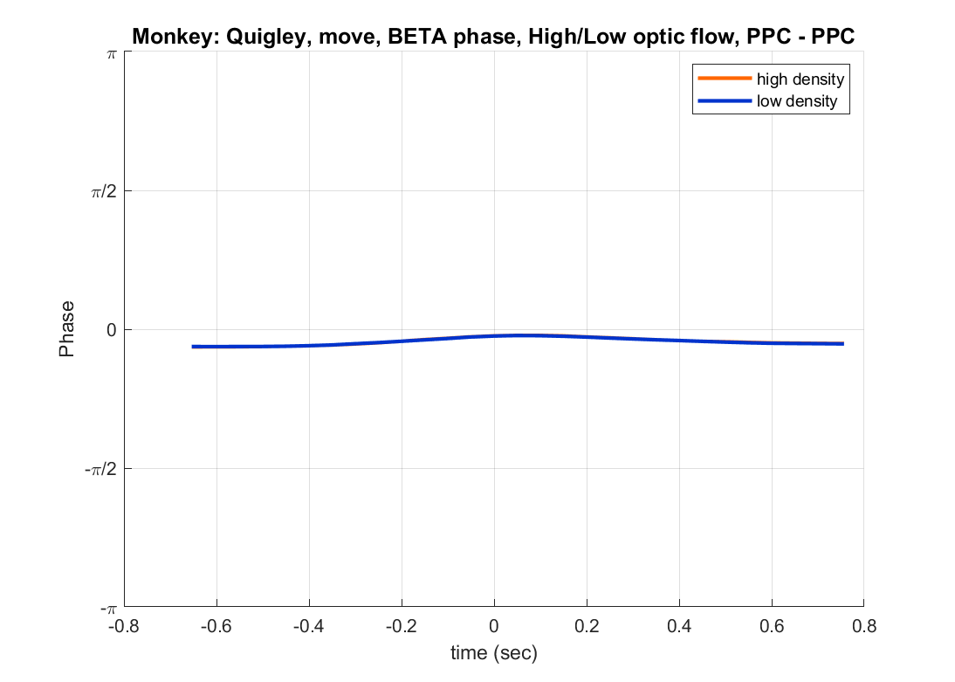

Slide 10
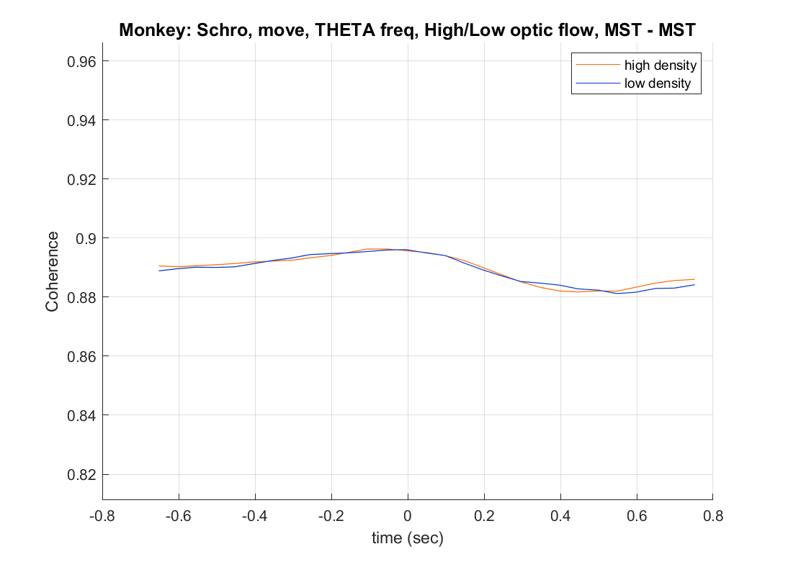
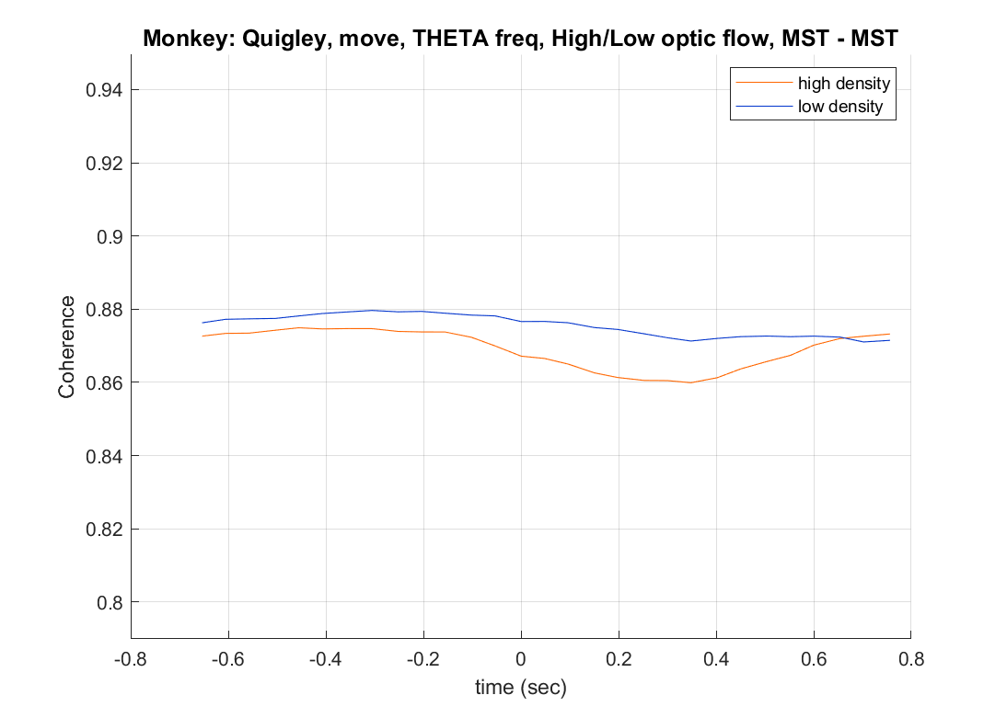
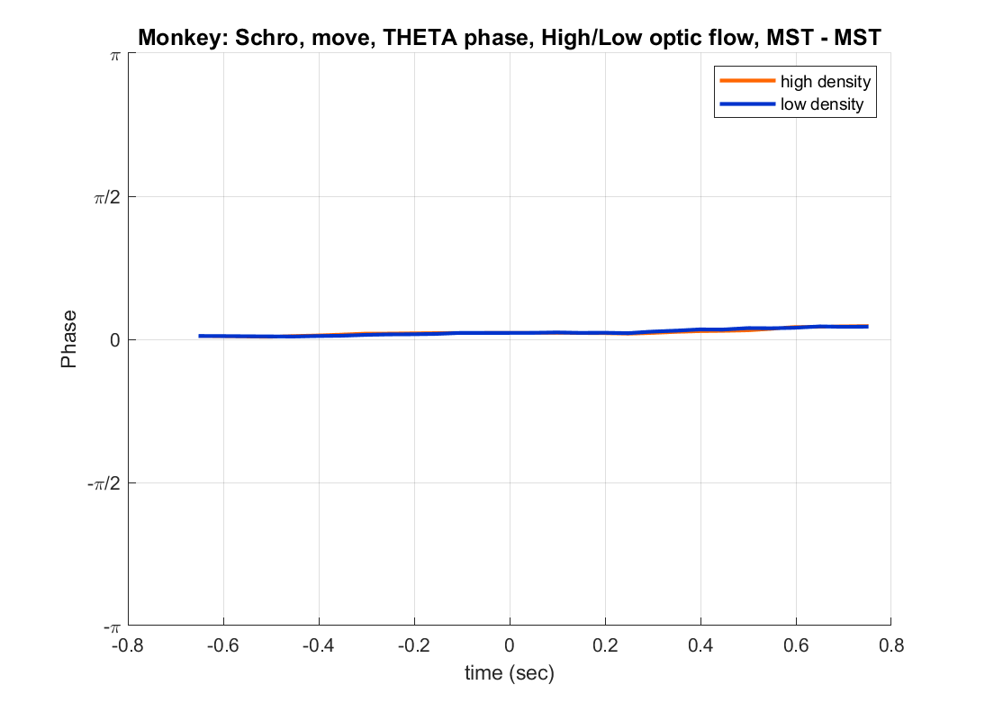


Slide 11
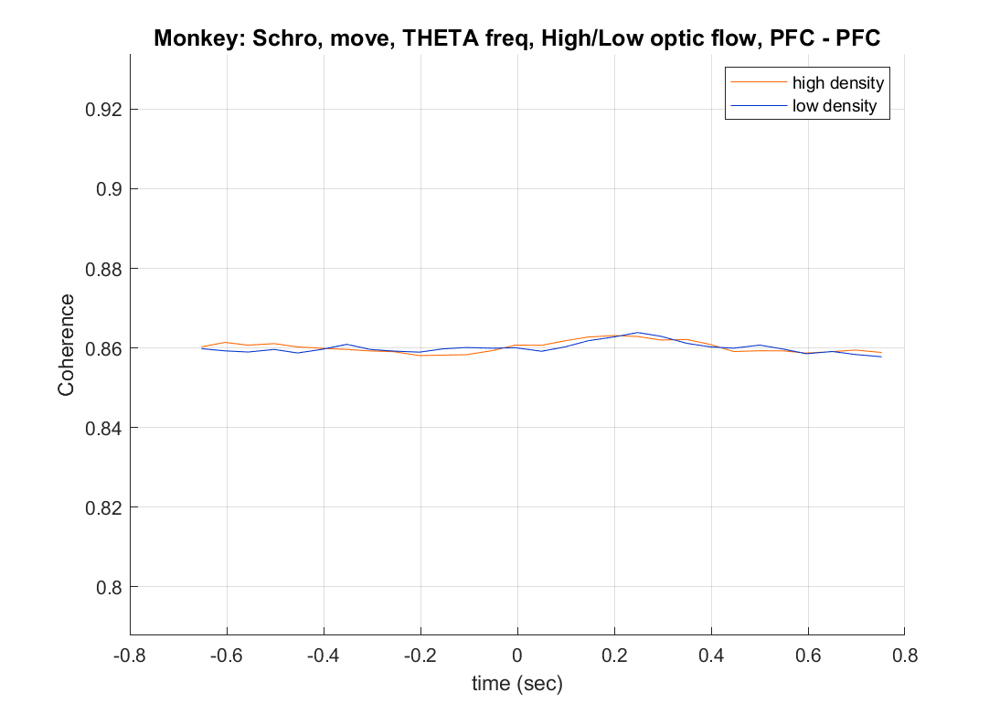
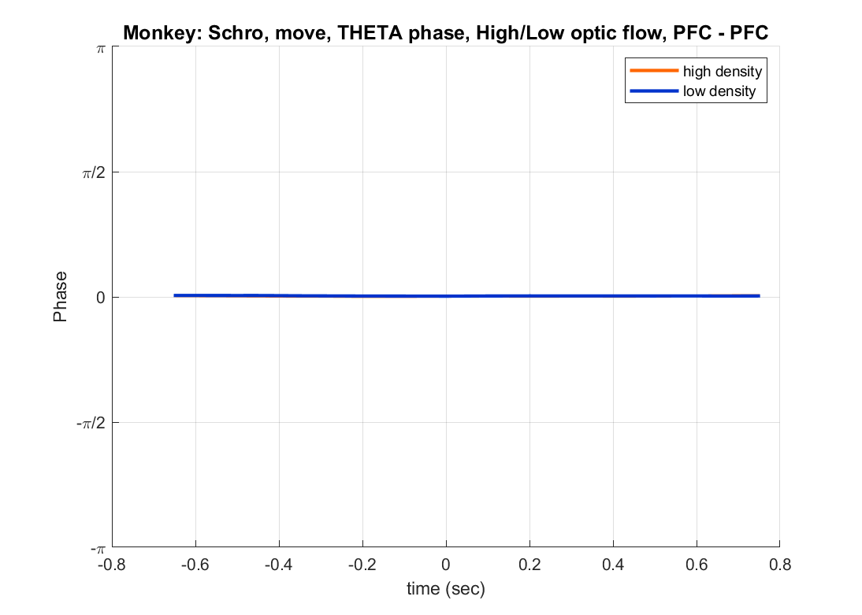

Slide 12
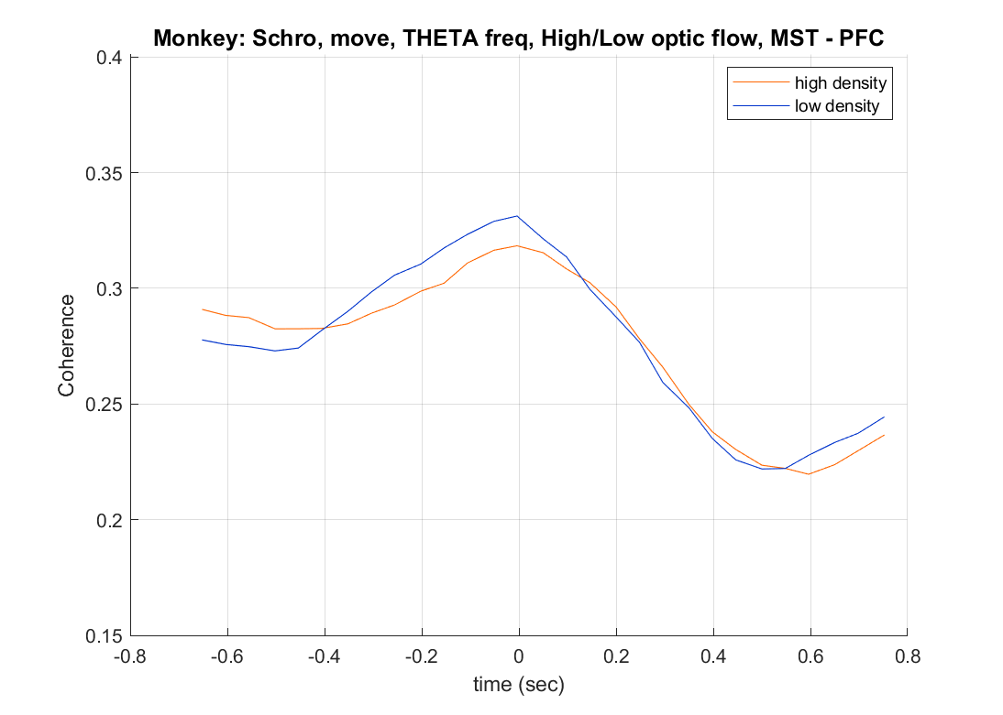
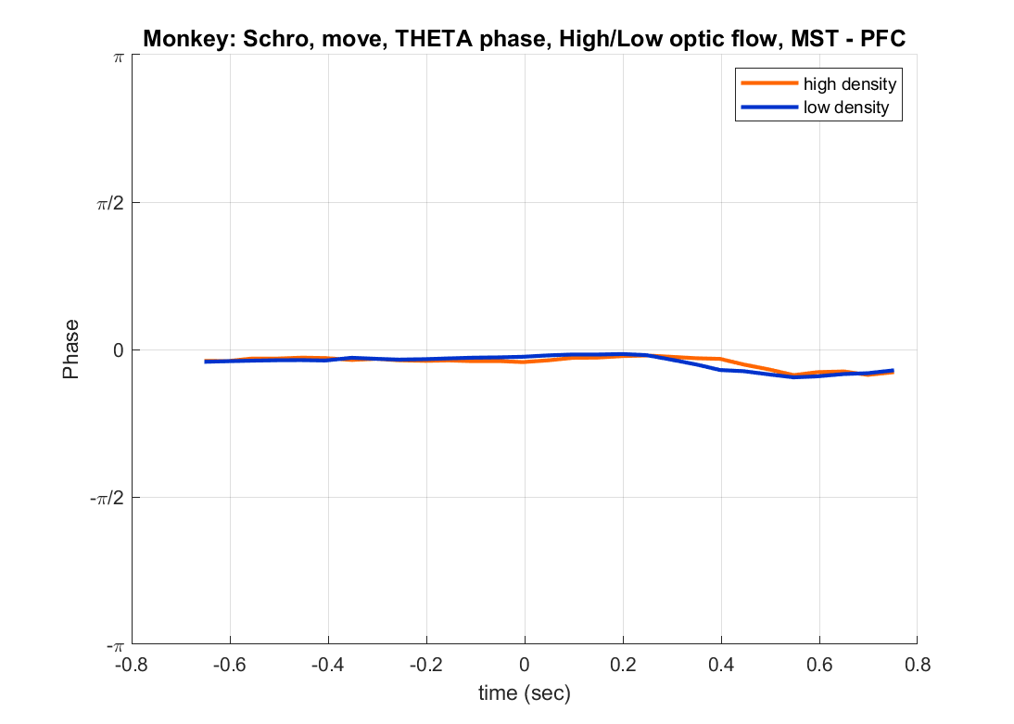
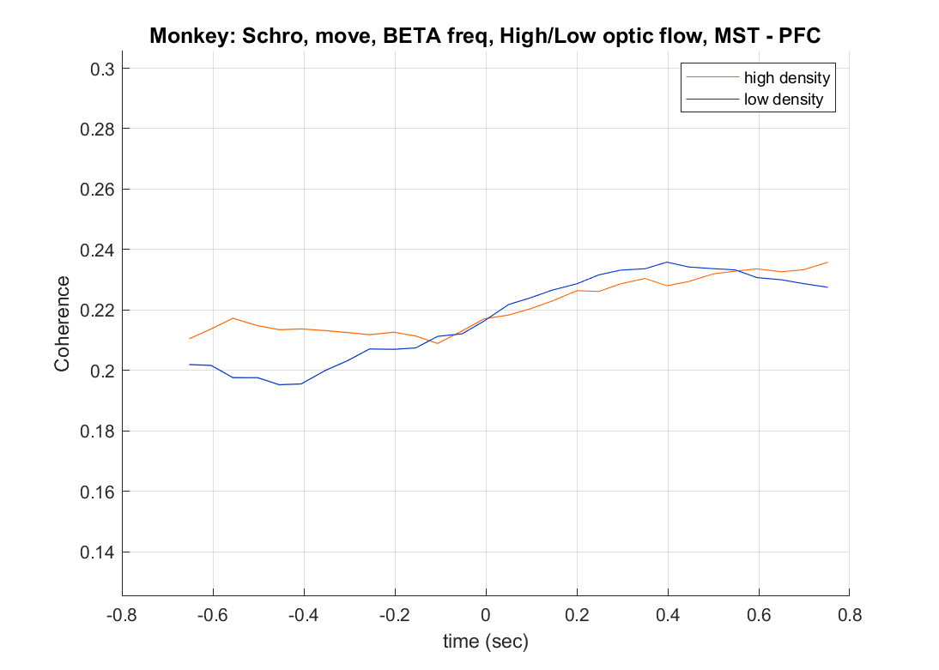
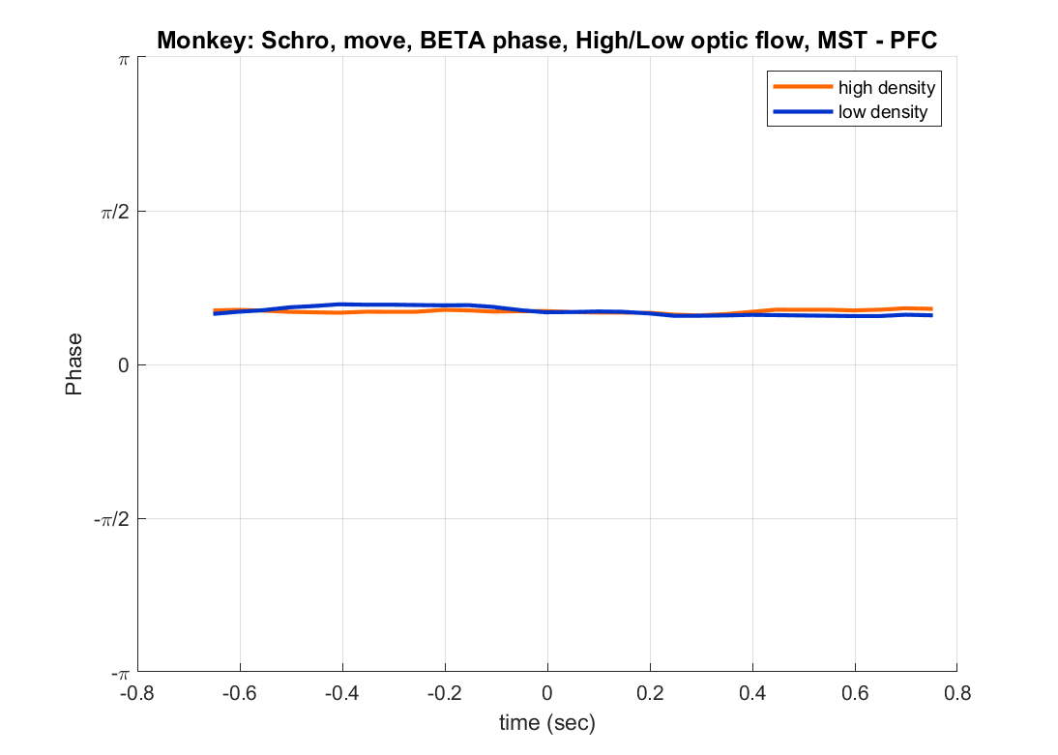

Slide 13
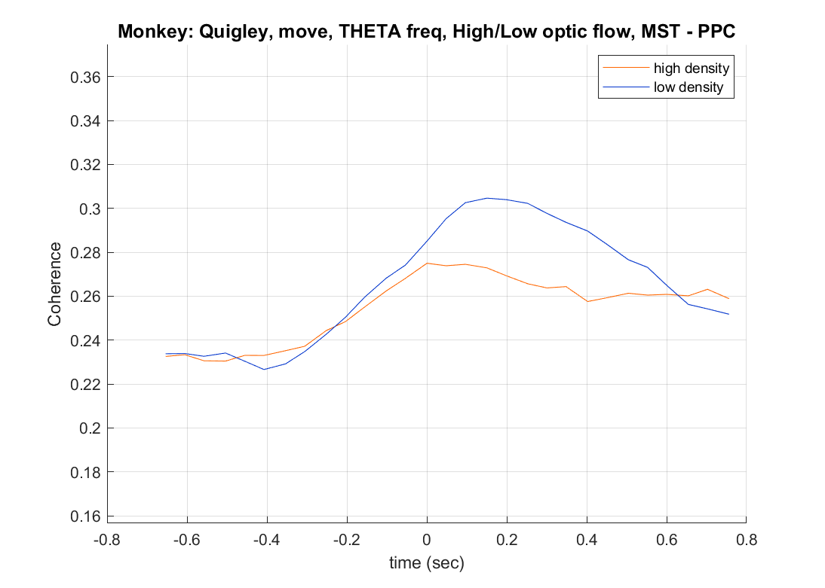
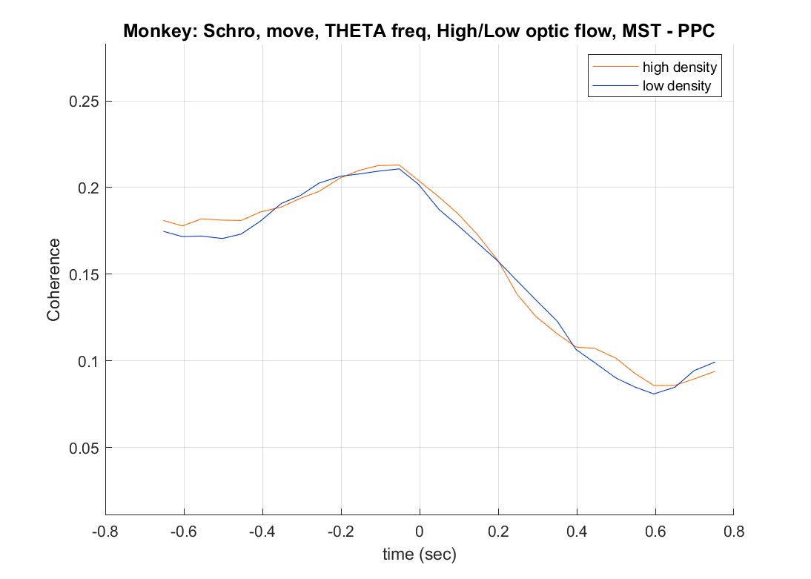
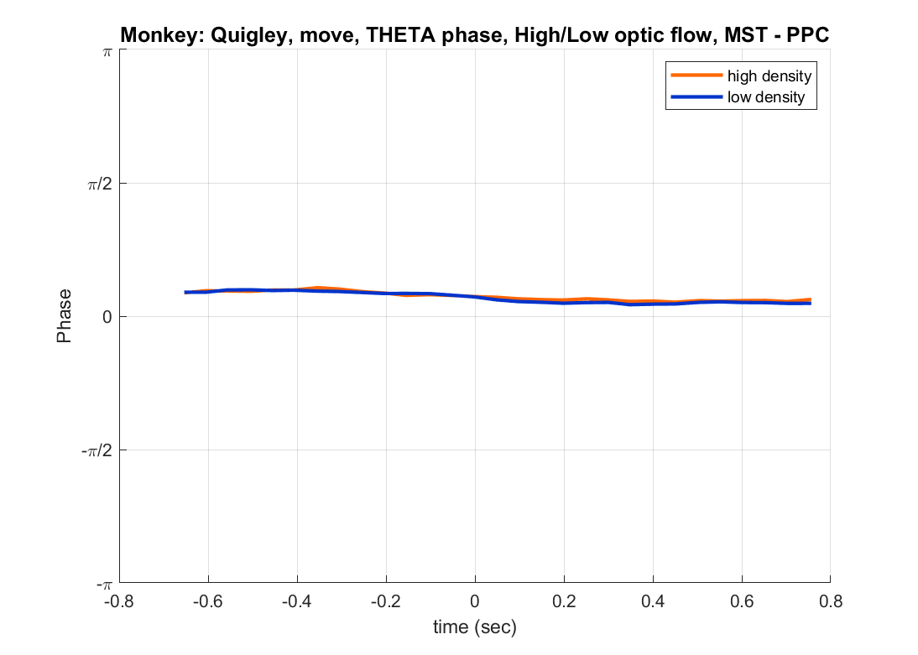
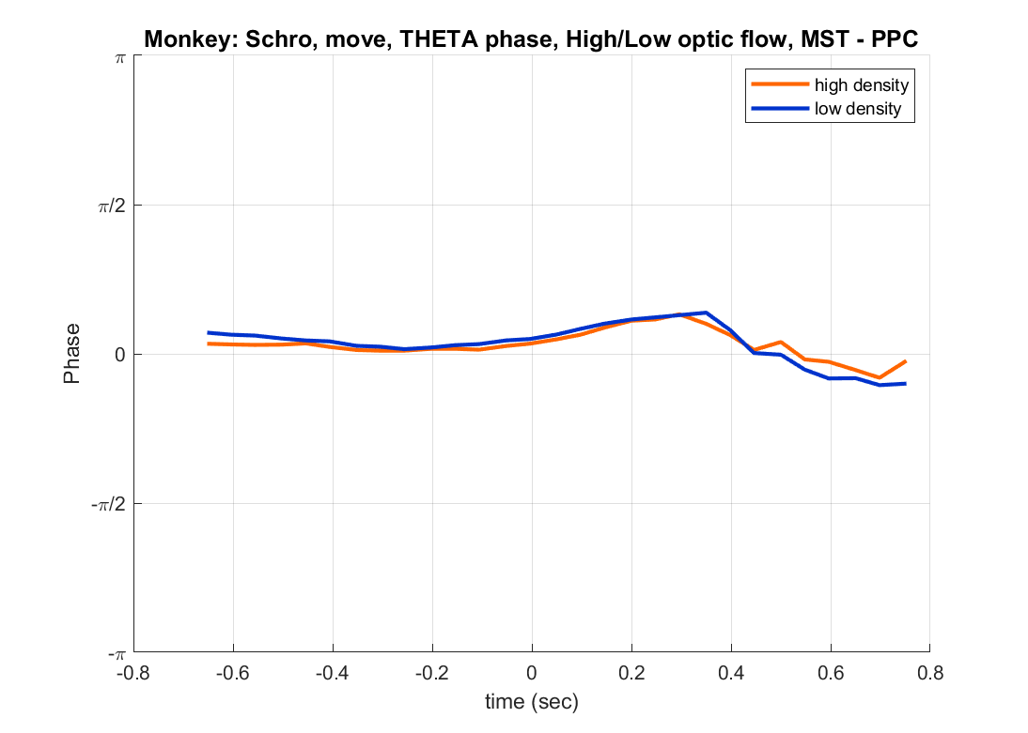

Slide 15
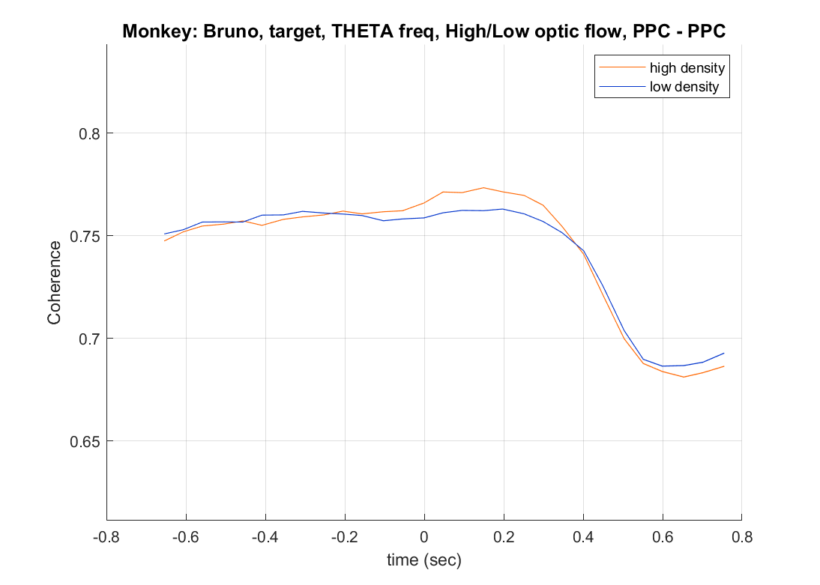
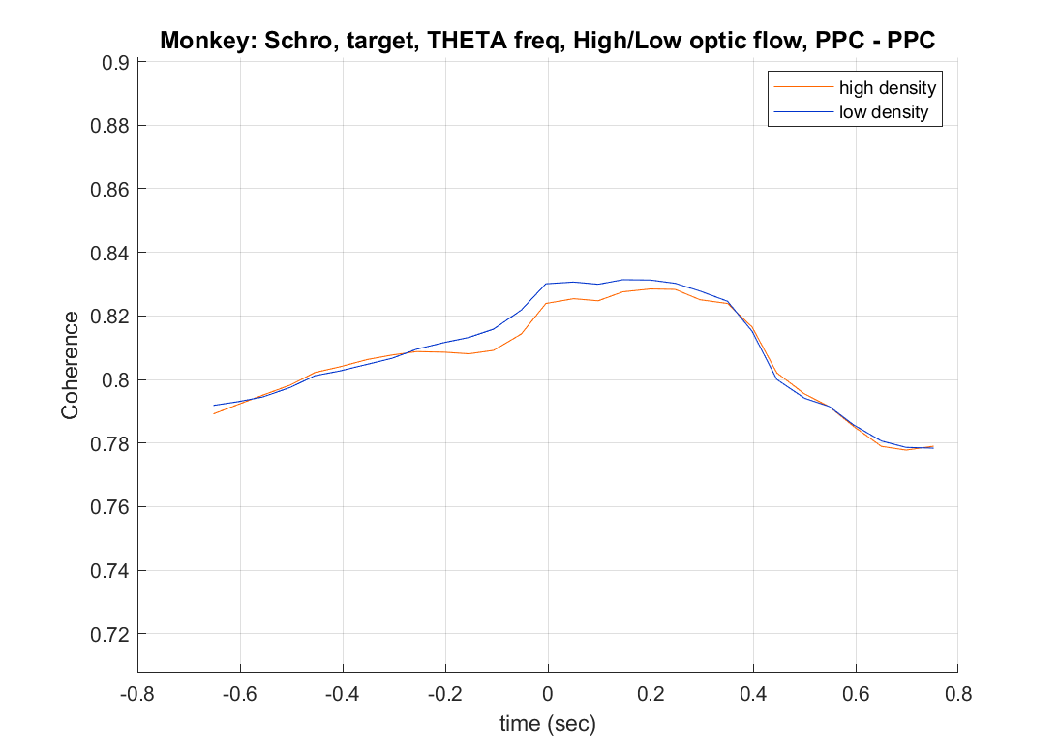
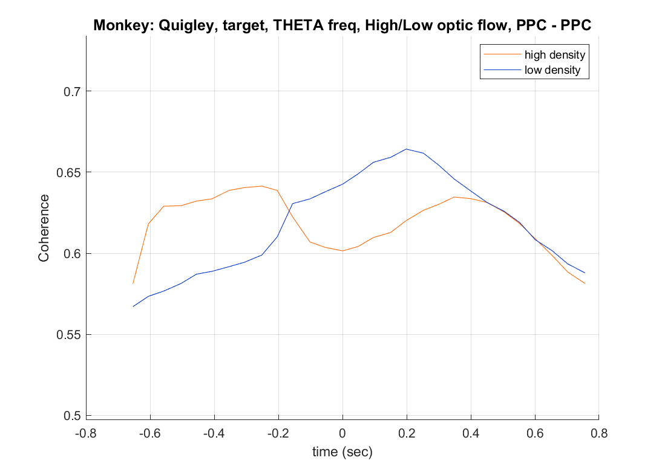

Slide 16
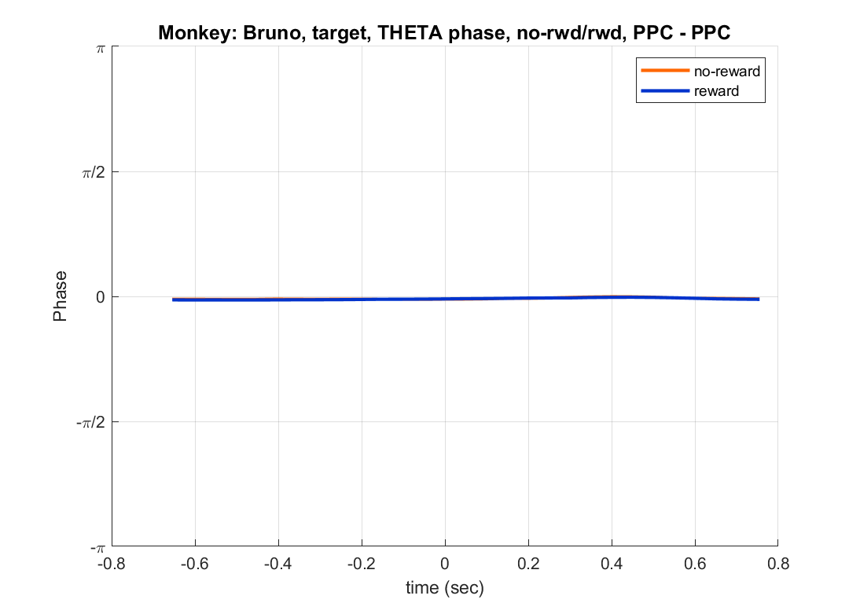
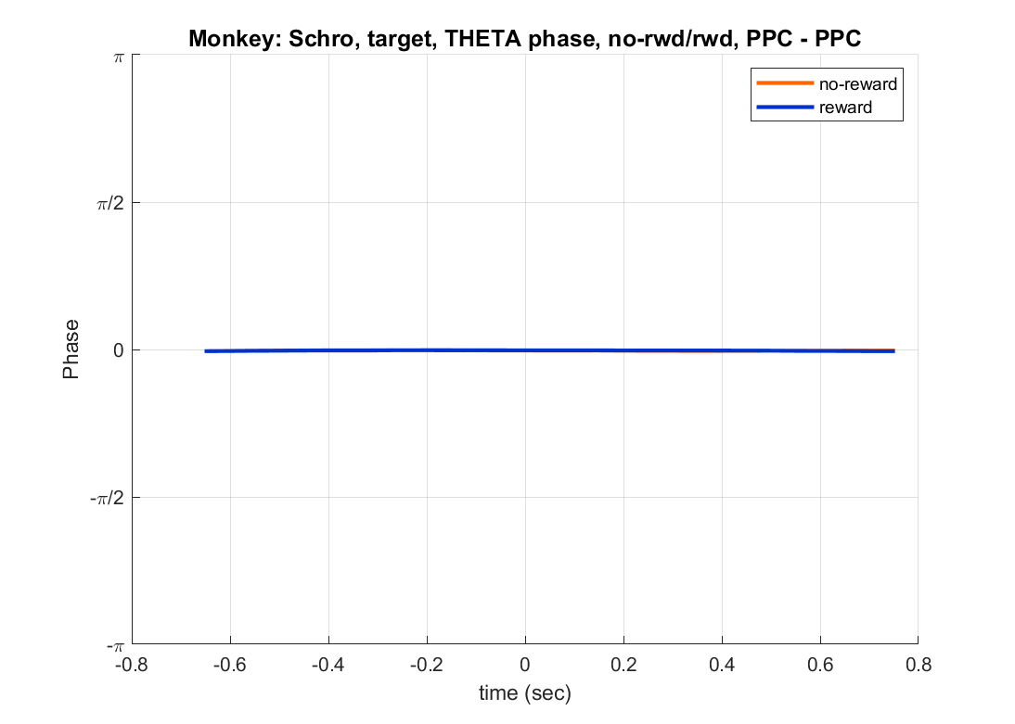
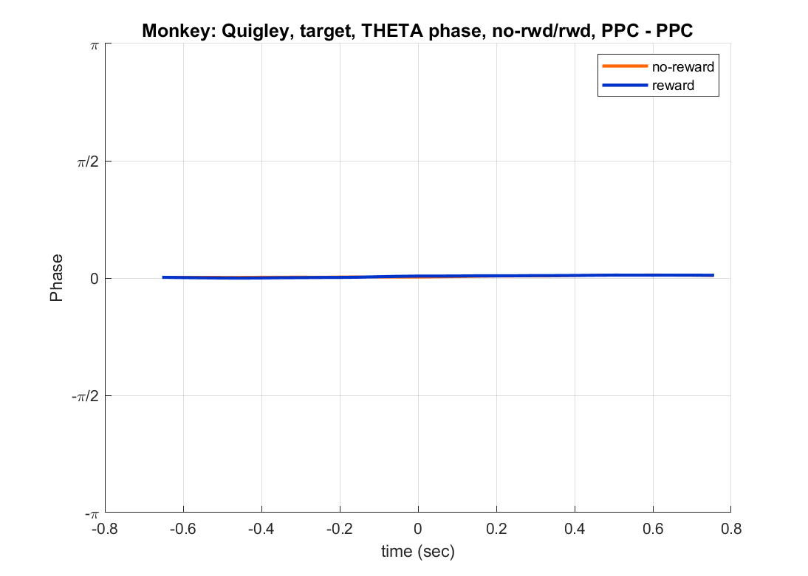

Slide 17
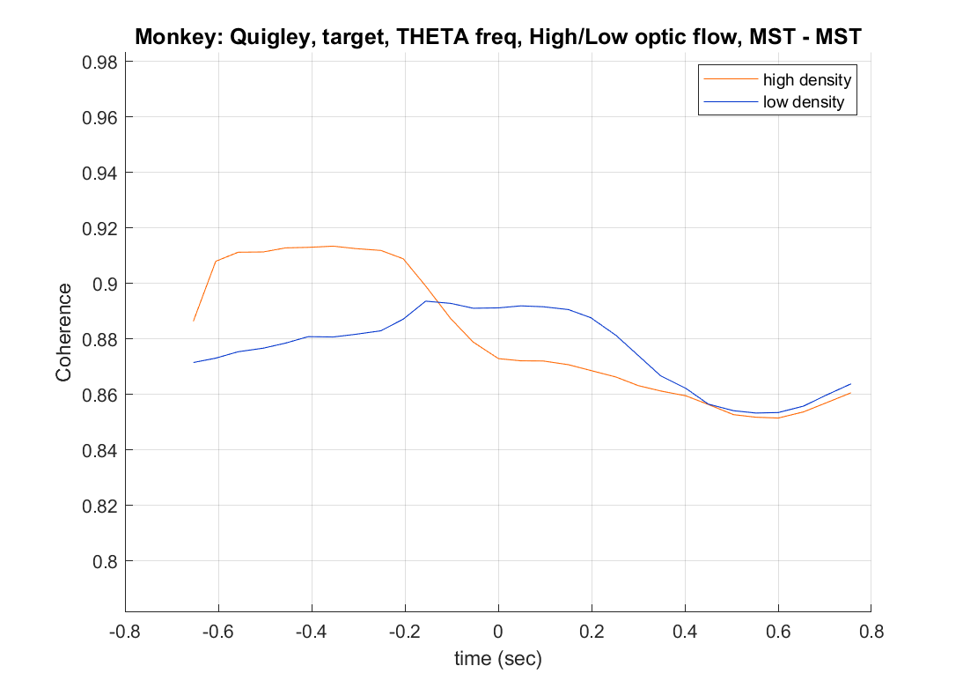
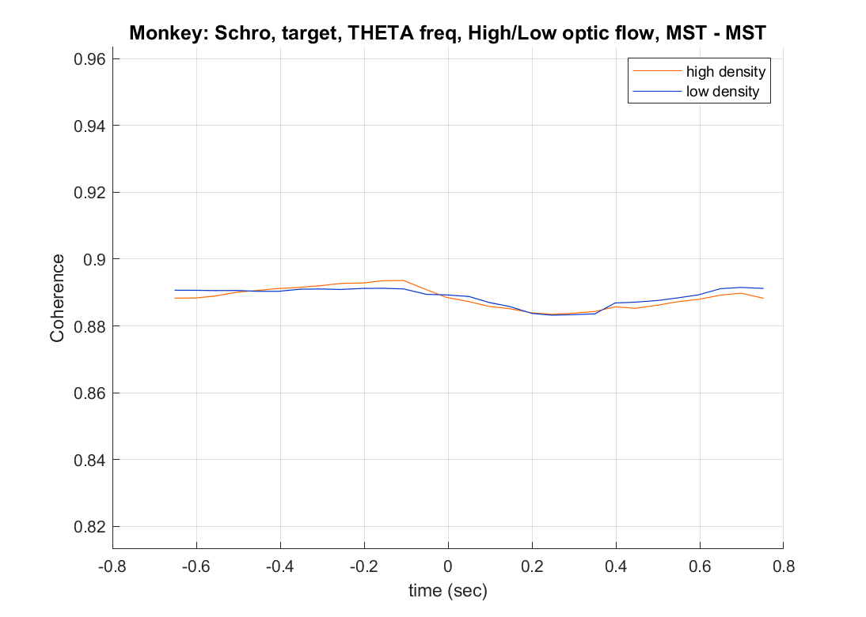

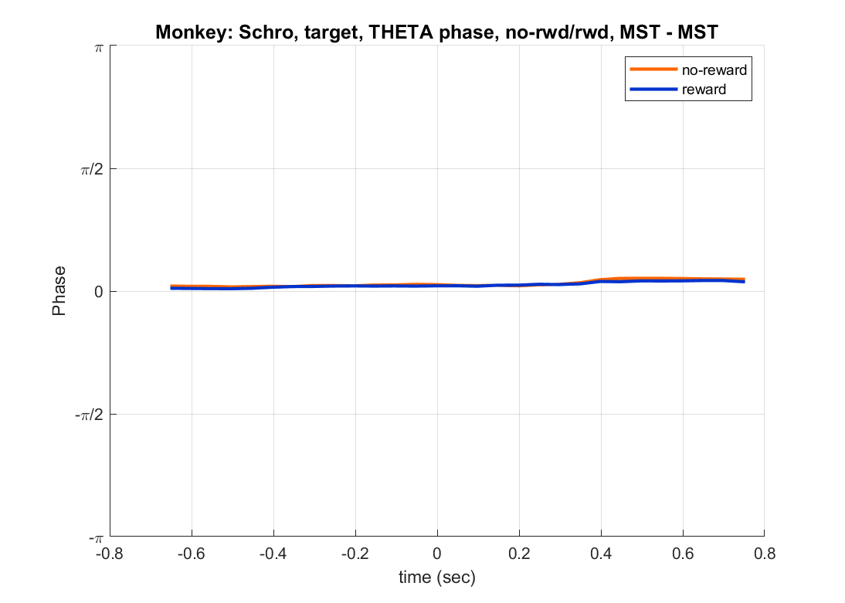

Slide 18
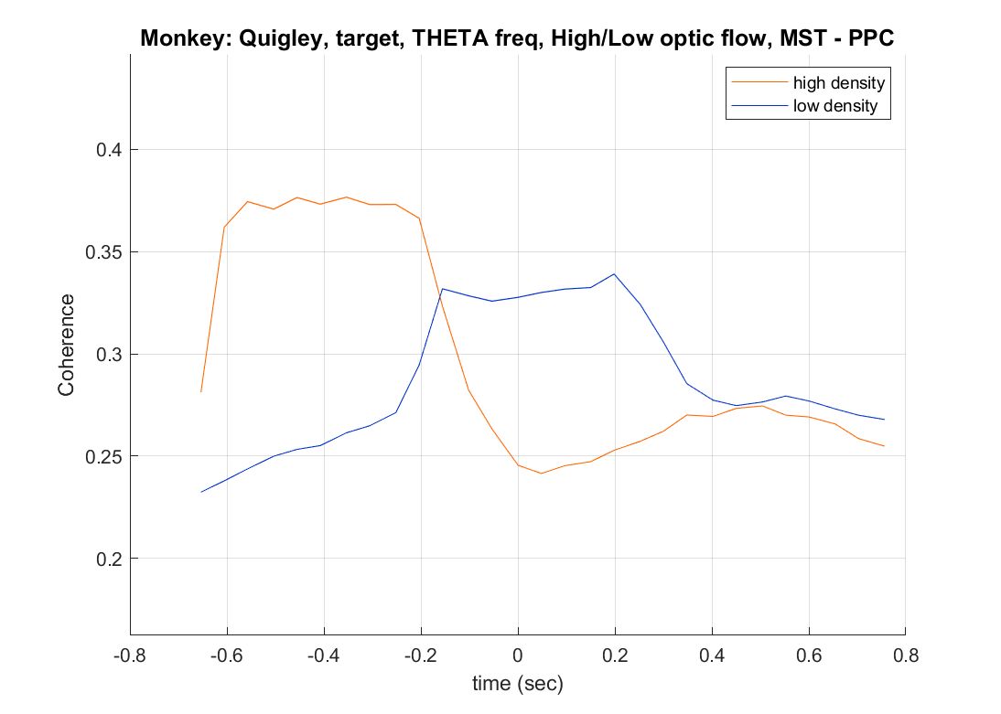
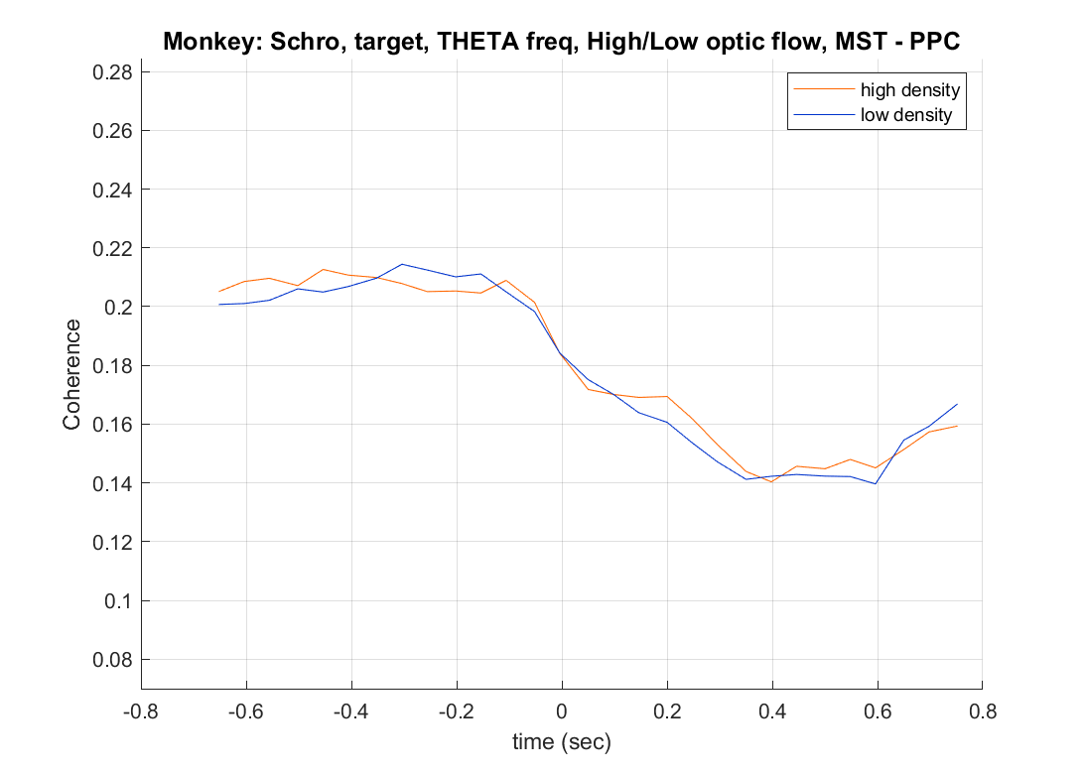
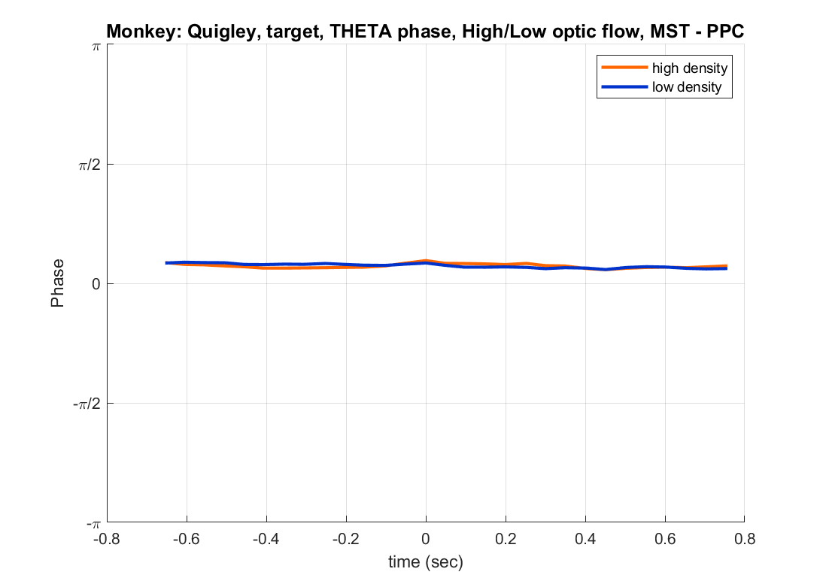
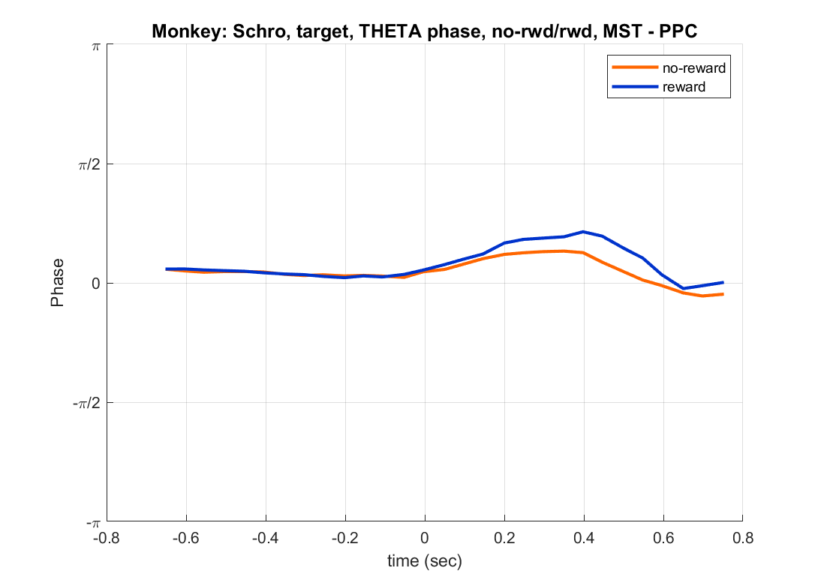

Slide 19
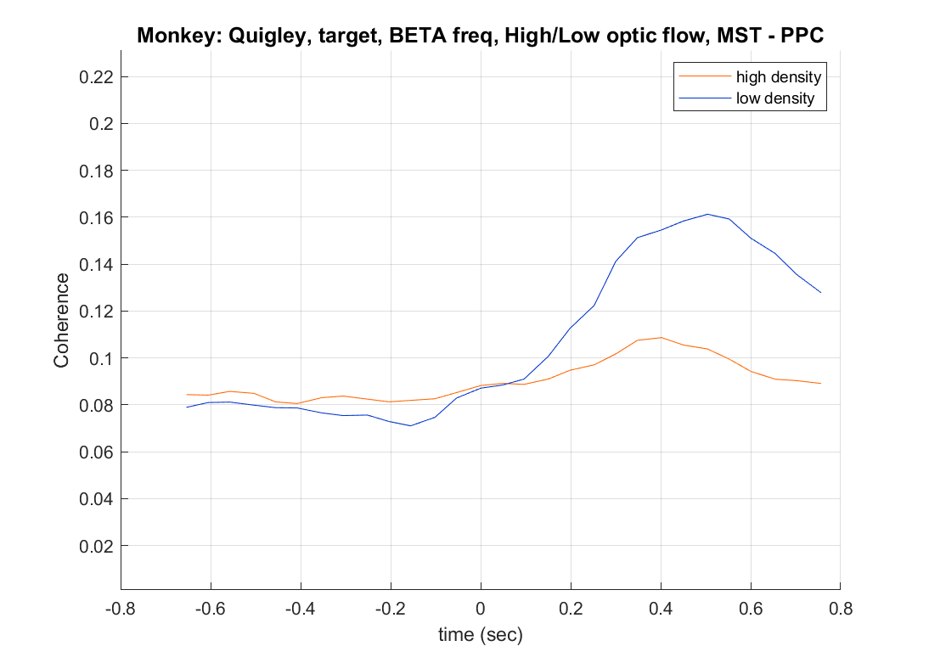
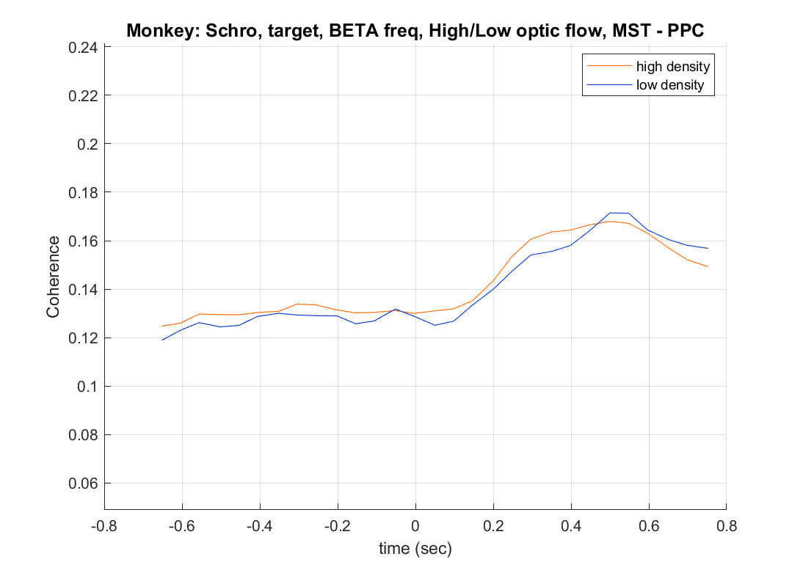
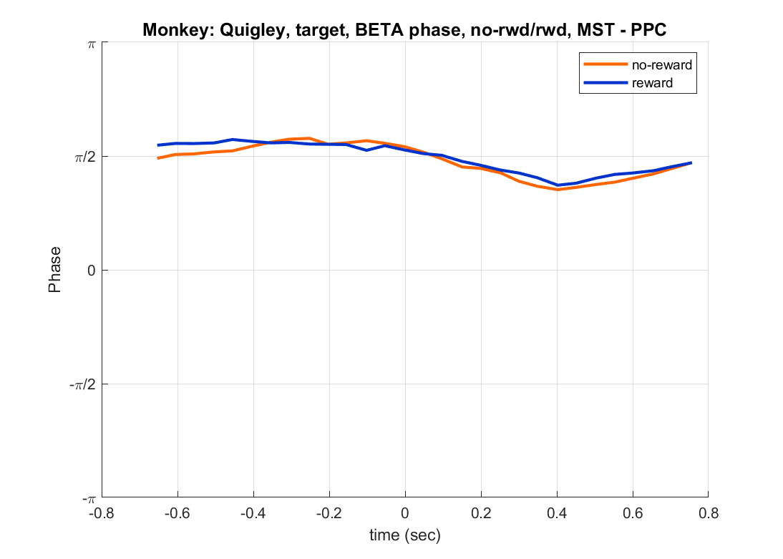
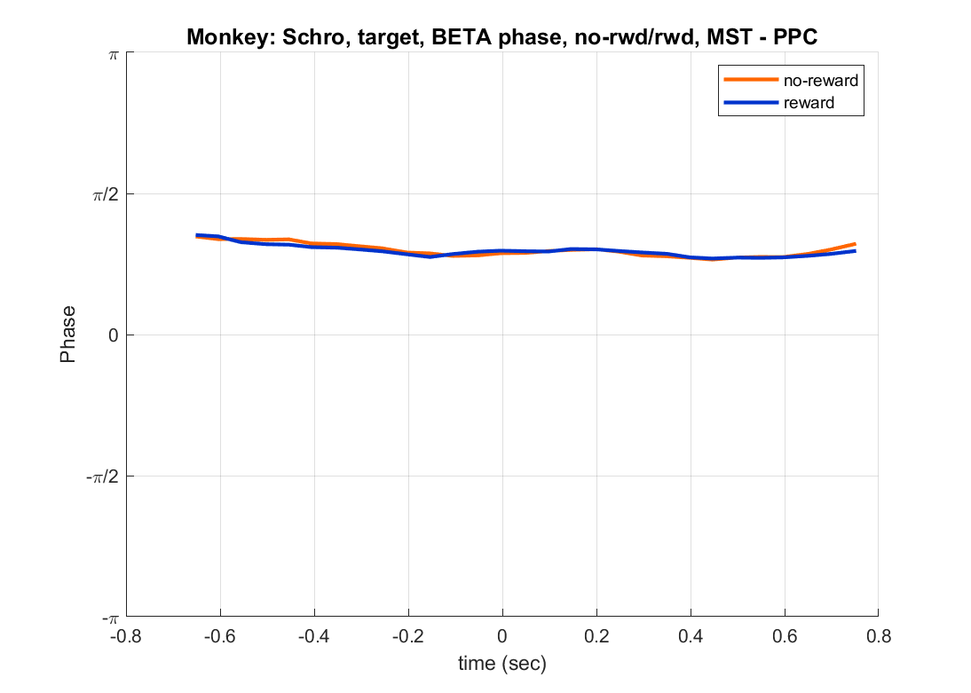

Slide 21
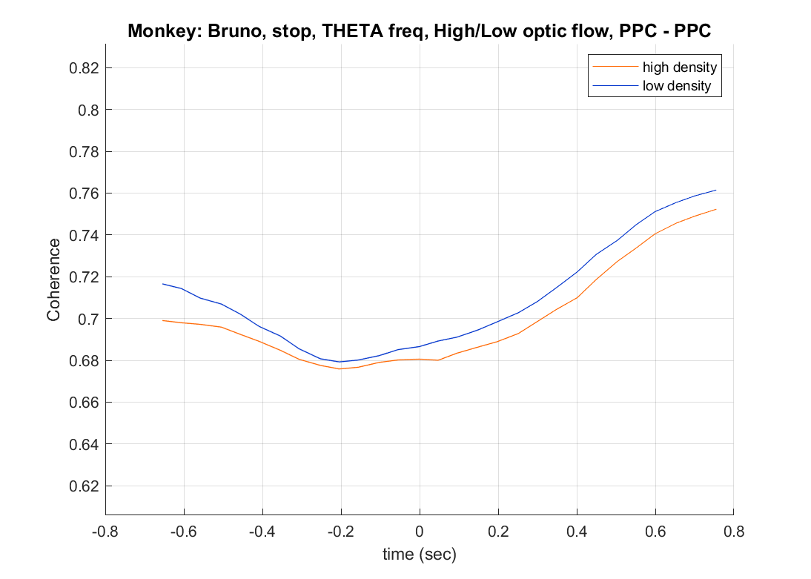
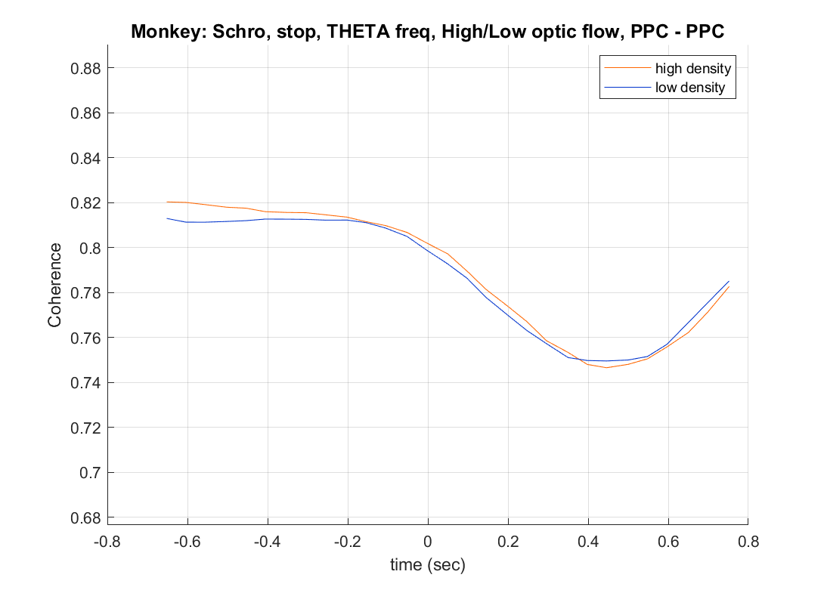
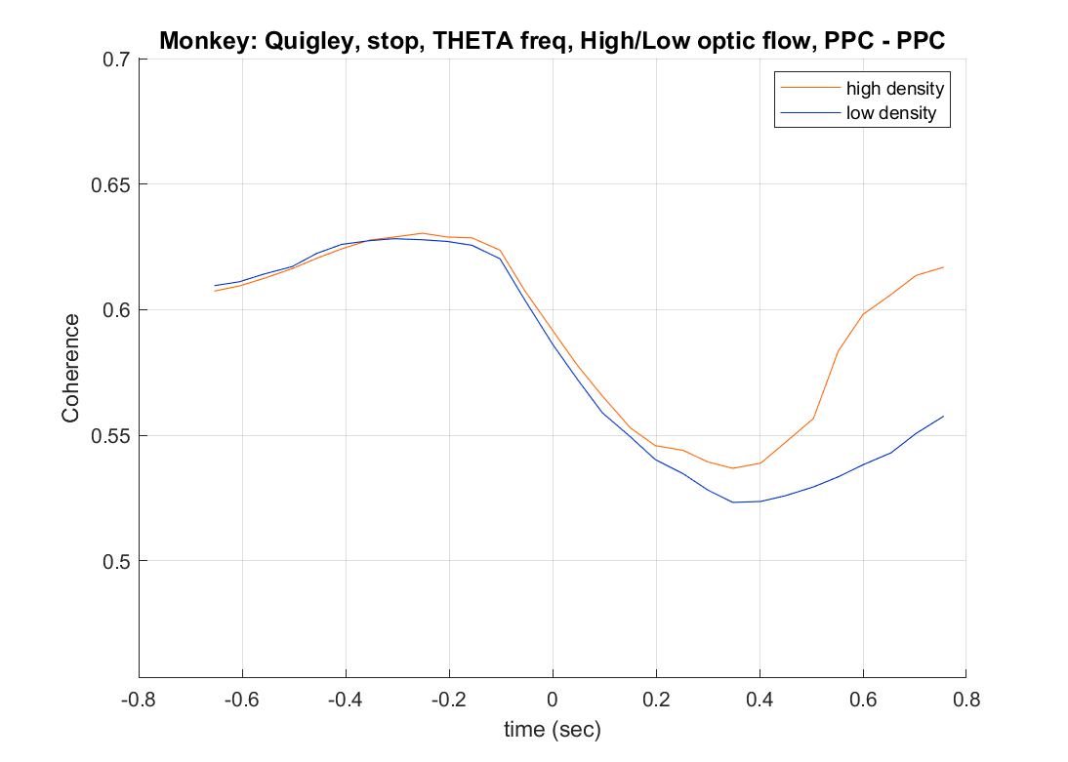

Slide 22
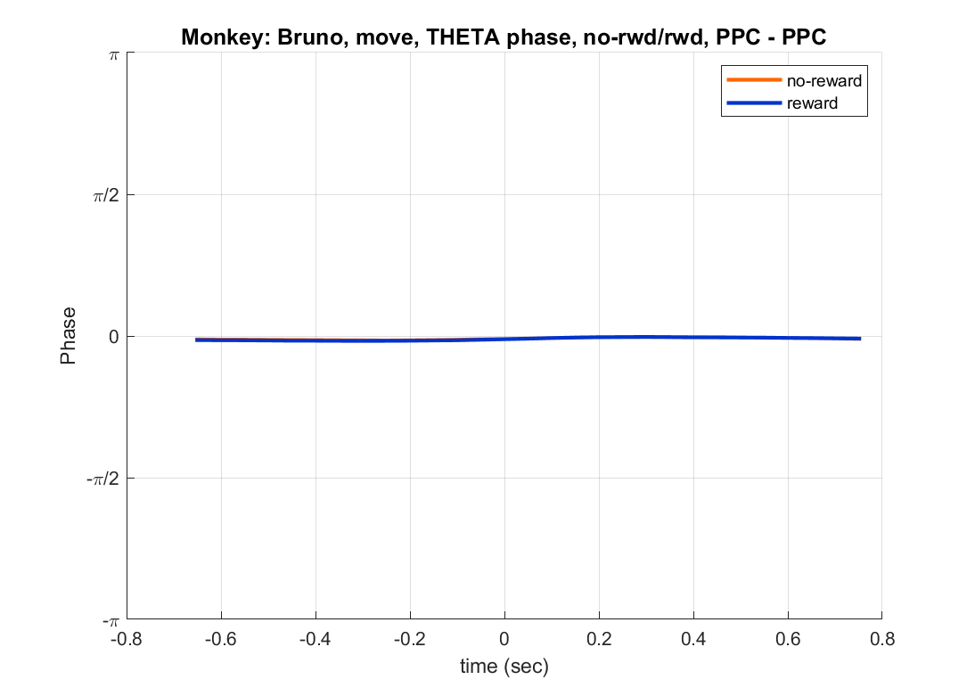
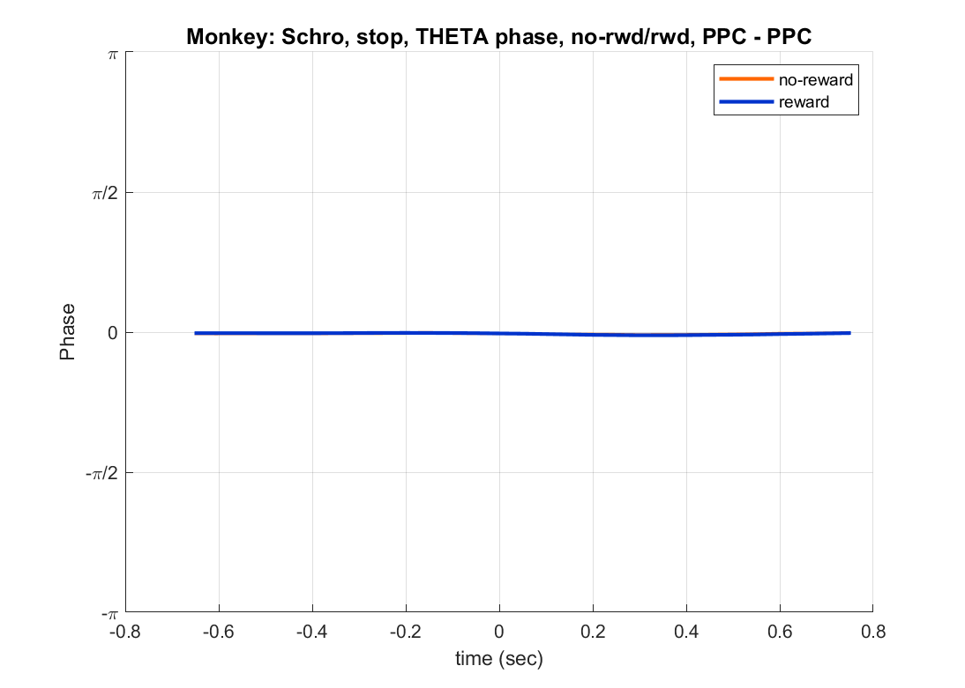
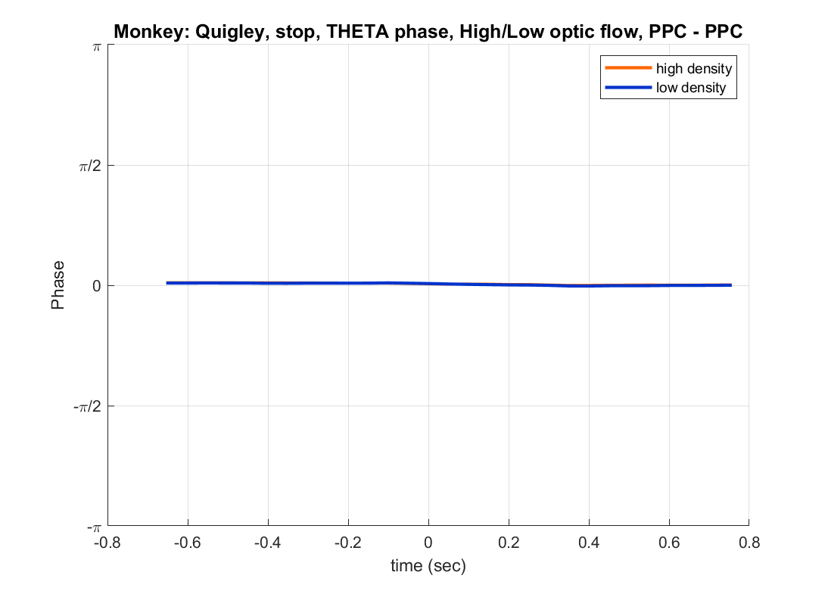

Slide 23
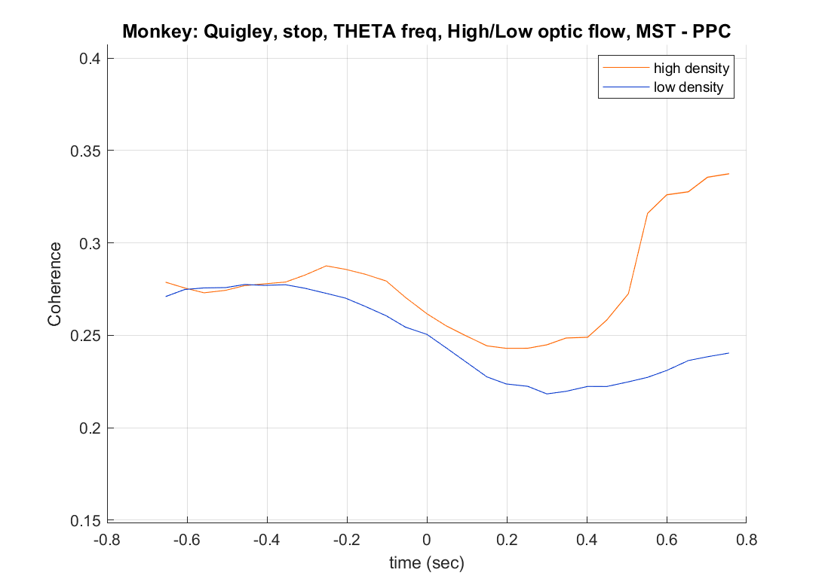




Slide 24




Slide 26



High-low density THETA frequency range

Slide 27



Reward-no-reward, THETA frequency range

Slide 28



Reward-no-reward, BETA frequency range

Slide 29



High-low density BETA frequency range

Slide 31
MEETING 4/18/23

Slide 32
DISCUSSION of Meeting on 2/6/23
SPECTROGRAMS/POWER
Check high/low optic flow density affects the neural activity
Plot spectrograms for high/low optic flow density trials
Plot theta frequency and beta frequency vs time for high/low optic flow trials .
COHERENCEGRAM/COHERENCE
Compute intra- and inter-coherence activity (coherence amplitude) for
1.a High/low density optic flow trials
2.a reward/no-reward trials
Do the same for the phase

Slide 33
DISCUSSION of Meeting on 2/6/23
SPECTROGRAMS/POWER
Check high/low optic flow density affects the neural activity
Plot spectrograms for high/low optic flow density trials
Plot theta frequency and beta frequency vs time for high/low optic flow trials .
COHERENCEGRAM/COHERENCE
Compute intra- and inter-coherence activity (coherence amplitude) for
1.a High/low density optic flow trials
2.a reward/no-reward trials
Do the same for the phase

Slide 34



PPC Target aligned, high – low density flow

Slide 35



PPC Target aligned, high – low density flow

Slide 36



PPC Move aligned, high – low density flow

Slide 37



PPC STOP aligned, high – low density flow

Slide 38



Power vs time, theta band, PPC, target aligned

Slide 39



Power vs time, theta band, PPC, move aligned

Slide 40



Power vs time, theta band, PPC, STOP aligned

Slide 41



Power vs time, beta band, PPC, target aligned

Slide 42



Power vs time, beta band, PPC, MOVE aligned

Slide 43



Power vs time, beta band, PPC, STOP aligned

Slide 44


Spectrogram, MST, target aligned

Slide 45


Power vs time, theta band, MST, Target aligned

Slide 46


Power vs time, theta band, MST, move aligned

Slide 47


Power vs time, theta band, MST, stop aligned

Slide 48


Power vs time, beta band, MST, Target aligned

Slide 49


Power vs time, beta band, MST, move aligned

Slide 50


Power vs time, beta band, MST, stop aligned

Slide 51



Spectrogram, PFC
target
move
stop

Slide 52



Power vs time, theta band, PFC, target aligned

Slide 53



Power vs time, beta band, PFC, target aligned

Slide 54
COHERENCE STUDY

Slide 55


COHERENCE MATRICES - PPC
DENSITY difference
RWD difference

Slide 56
BRUNO – PPC only
DENSITY difference
RWD difference

Slide 57
QUIGLEY – MST, PPC

Slide 58
SCHRO – MST, PFC, PPC

Slide 59



COHERENCE vs FREQUENCY – PPC-PPC

Slide 60


COHERENCE vs FREQUENCY – MST-MST

Slide 61


Slide 62


COHERENCE vs FREQUENCY – MST-PPC

Slide 63


COHERENCE vs FREQUENCY – PFC-PPC and PFC-MST

Slide 64




COHERENCE vs FREQUENCY – PPC-PPC

Slide 65




COHERENCE vs FREQUENCY – PPC-PPC

Slide 66




COHERENCE vs FREQUENCY – PPC-PPC

Slide 67


COHERENCE vs FREQUENCY – PFC-PFC

Slide 68




COHERENCE vs FREQUENCY – MST-PPC - density

Slide 69




COHERENCE vs FREQUENCY – MST-PPC - rwd

Slide 70


COHERENCE vs FREQUENCY – MST-PFC

Slide 72
MEETING 3/7/23

Slide 73





Slide 74

I checked another session (not included in the current analysis) where Quigley has PPC with linear probe. We find the same amplitude than in MST – therefore the rescaling in amplitude is due to the probe and not the area/recording

Slide 75




Comparison reward with no reward for PPC - target

Slide 76





Slide 77




Comparison reward with no reward for PPC - stop

Slide 78




PPC - Target

Slide 79




PPC - move

Slide 80




PPC - stop

Slide 81






Quigley
MST
Schro
MST - Target
MST - move
MST - stop

Slide 82






Schro
PFC
Vik
PFC - Target
PFC - move
PFC - stop

Slide 83






PPC – Target - theta

Slide 84






PPC – Target - beta

Slide 85






PPC – stop - theta

Slide 86






PPC – stop - beta

Slide 92
MEETING 2/6/23

Slide 93
BRUNO

Slide 94




BRUNO
LOG power difference: no-reward - reward
Target

Slide 95




BRUNO
Theta band
Beta band
Target

Slide 96




BRUNO
LOG power difference: no-reward - reward
Move

Slide 97




BRUNO
Theta band
Beta band
Move

Slide 98




BRUNO
Spectrogram – Power Spectral Density
Target
Move
PPC

Slide 99
VIK

Slide 100




VIK – Target - PPC

Slide 101




VIK – Move - PPC

Slide 102




VIK – Target - PFC

Slide 103




VIK – Move - PFC

Slide 104
QUIGLEY

Slide 105




Quigley – Target - MST

Slide 106




Quigley – Move - MST

Slide 107




Quigley – Target - PPC

Slide 108




Quigley – Move - PPC

Slide 109
SCHRO

Slide 110




Schro – Target - MST

Slide 111




Schro – Move - MST

Slide 112




Schro – Target - PPC

Slide 113




Schro – Move - PPC

Slide 114



Schro – Target - PFC

Slide 115



Schro – Move - PPC

Slide 116


PSD difference - PFC

Slide 117


PSD difference - PPC

Slide 118

PSD difference - MST

Slide 119
MEETING 1/20/23

Slide 120
Is it possible to predict rewarded/unrewarded trial, on a trial-by-trial basis, from:
Spectral features only
1. One-body features
(i) Theta/beta power vs time
(ii) Spectrogram (frequency vs time)
(iii) PSD (spectrum), unlikely!
(iv) Phases
2. two-body features
(i) Pairwise coherence
(ii) Cross-phase difference
(iii) Phase-amplitude coupling
b. Eye tracking
c. Combination of spectral features and eye tracking
d. Manipulation

Slide 121
Preliminary analysis: gaining insights into spectral features and justifying a trial-by-trial analysis
Average analysis for spectral features:
1. Compute spectral feature for rewarded/unrewarded trials (monkey by monkey, region by region)
2. Compute difference for SF unrewarded - rewarded
3. Comparison: z-score results (not by normalizing power!)
3.1 Non-parametric statistical test (permutation test)
a. Pixel-correction (thresholding)
b. Cluster correction (much better approach)

Slide 122
ROAD MAP:
Spectral features:
Average analysis for 2. two-body features
(i) Pairwise coherence
(ii) Cross-phase difference
(iii) Phase-amplitude coupling
Trial-by-trial analysis
Build a model to predict rwd/unrwd trials based on spectral features.
Input features: theta/beta power, theta/beta phase, inter-region phase coupling, ….
Models: GLM, GAM, Multilayer Perceptron.
Models: Use CNN on spectrogram to predict rwd/unrwd trials with spectrogram as inputs.
b. Eye tracking
Average analysis:
See if fixation on the target for longer time predicts (on average) rwd vs unrwd trials
Trial-by-trial analysis
Use fixation time and x/y position as predictors
c. Combination of spectral features and eye tracking
combine the above predictors together

Slide 123
BRUNO
LOG power difference: no-reward - reward
Target
move

Slide 124
BRUNO
Theta band
Beta band
Target
Move

Slide 125
BRUNO
Spectrogram – Power Spectral Density
Target
Move
PPC

Slide 126



BRUNO
Z-scored Spectrogram
Z-scored Spectrogram (thresholded, p = 0.05)
Z-scored Spectrogram (cluster corrected)

Slide 127
ViK
LOG power difference: no-reward - reward
Target
move
PFC
PPC

Slide 128




VIK - PFC
Theta band
Beta band
Target
Move

Slide 129




VIK - PPC
Theta band
Beta band
Target
Move

Slide 130




VIK
Spectrogram – Power Spectral Density
Target
Move
PFC
PPC

Slide 131
Quigley
LOG power difference: no-reward - reward
Target
move
MST
PPC

Slide 132




Quiegly - MST
Theta band
Beta band
Target
Move

Slide 133




Quiegly - PPC
Theta band
Beta band
Target
Move

Slide 134




Quigley
Spectrogram – Power Spectral Density
MST
PPC

Slide 135


Schro
LOG power difference: no-reward - reward
Target
move
MST
PFC
PPC

Slide 136




Schro - MST
Theta band
Beta band
Target
Move

Slide 137




Schro - PFC
Theta band
Beta band
Target
Move

Slide 138



Schro - PPC
Theta band
Beta band
Target
Move

Slide 139


Issue with MST or Linear Probe or both – Need further investigation
Quigley

